Slide 1
Solution Walkthrough Presentation
Challenges, Decisions, and Innovations

Slide 2
Introduction
1. Project Overview
Scenario: Sentiment analysis of product reviews.
Goal: Build a model to classify reviews as positive, neutral, or negative.
2. Objective
Sentiment Classification: Classify reviews.
Real-time API: Provide sentiment predictions.
3. Approach
Data Preprocessing: Tokenization, stopword removal, lemmatization.
Model: Logistic Regression with TF-IDF.
API: Flask app with /predict and /health endpoints.
Deployment: Hosted on Render.

Slide 3
Challenges Faced
Key Challenges
Large model files for deployment.
2. Challenge Identification
Imbalance detected through class distribution analysis.
Overfitting identified via model performance metrics.
Model size issue encountered during deployment.
3. Constraints
Data Quality issues and deployment platform limits.
Data Imbalance and Overfitting.

Slide 4
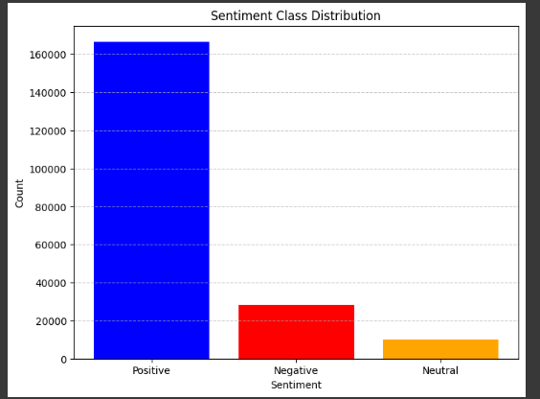
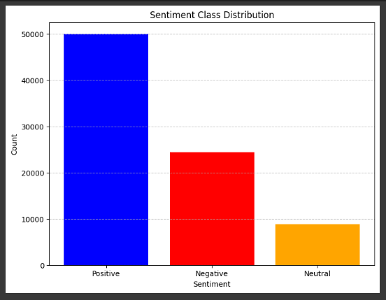
Under sampling of data

Slide 5
Key Decisions Made
Major Decisions
Model: Logistic Regression for simplicity and effectiveness.
Vectorization: TF-IDF for efficient text representation.
Deployment: Render/Heroku for easy and quick deployment.

Slide 6
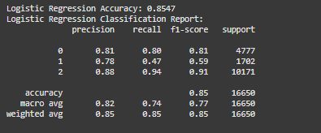
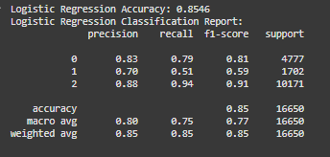
Tfidf-vectorizer vs Count-vectorizer
Using Tfidf-vectorizer
Using Count-vectorizer

Slide 7
Innovations and Highlights
Innovative Features
Used TF-IDF with Logistic Regression for efficiency.
Built a real-time REST API with /predict and /health endpoints.
Enabled seamless cloud deployment
for scalability and accessibility.

Slide 8
Technical Overview
Architecture: Preprocessing (TF-IDF) → Logistic Regression Model → REST API.
Technologies: Python, Flask, scikit-learn, Render for deployment.
Key Modules:
Preprocessing: Cleans and vectorizes text using TF-IDF.
Model: Logistic Regression for sentiment prediction.
API: /predict for predictions, /health for monitoring.

Slide 9
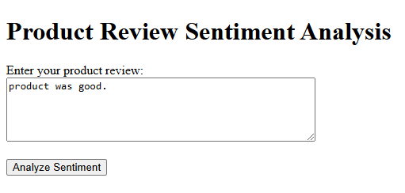
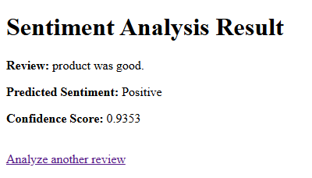
Demo and Workflow
Positive Sentiment

Slide 10
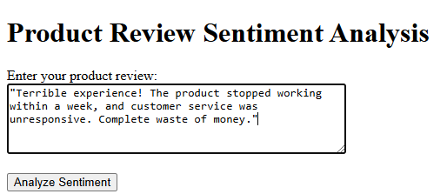
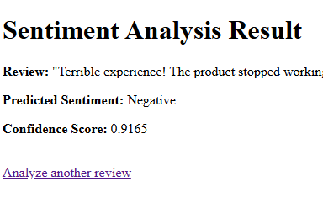
2.Negative Sentiment

Slide 11
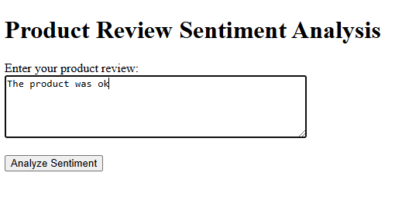
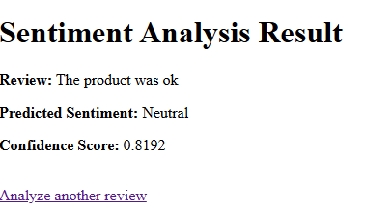
3. Neutral Sentiment

Slide 12
Lessons Learned and Future Scope
Implementation Insights and Future Plans
Key Takeaways: Efficient model design and deployment are critical;
handling imbalanced data is a key challenge.
Suggestions for Improvement: Use a larger, balanced dataset and
consider advanced models for better accuracy.
Future Enhancements: Integrate deep learning, real-time data pipelines, and
multi-language sentiment analysis.

Slide 13
Questions & Answers
Open the floor for questions and feedback.

